Slide 1
Forest Monitor Mapping System
Team Members
Abhishek Gupta
Sanjeev Mainali
Sunil lamsal
Surya Raj Timsina
Sushil Pokhrel

Slide 2
Challenge
Land Cover change and contributing factors
Crowd Sourced Data
Data Visualization, Collection
Rate and intensity
Map events
Platform for people(share)

Slide 3
Consideration
GPS
Estimation of land Area
Explain reasons behind it
Upload relevant images
Key dates/events/place
Sharing (Domain – Public, Government)

Slide 4
Features
Graphical representation of available data.
Trend Analysis
People awareness-> showing data use -> analysis
Alarming / Notification to concerned authority
Micro-level Analysis

Slide 5
What we did…
A platform for Forest Monitor Mapping(CRUD).
Comparison & findings of available data.

Slide 6
Benefits / Impacts …
History viewing
Compare and Contrast (INSITU)
Manipulate Visualized data
Using chart, one can easily identify the area that needs to be focused regarding deforestation.

Slide 7
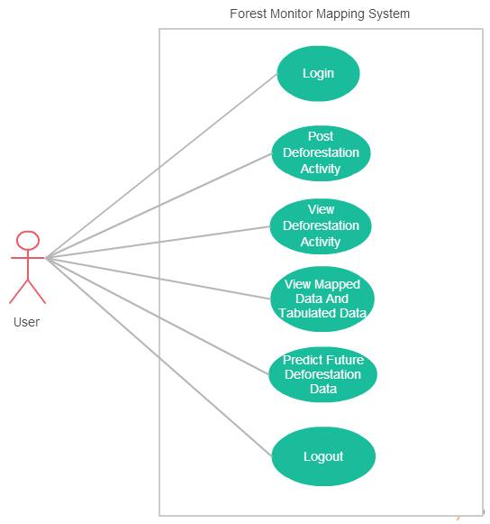
Use case Diagram: User

Slide 8
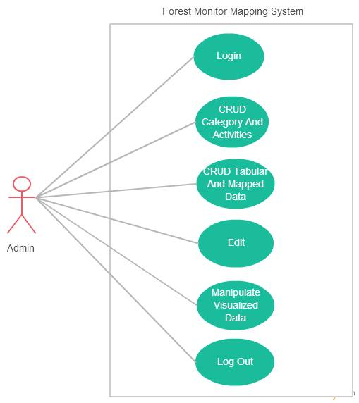
Use case Diagram: Admin

Slide 9
Data Source

Slide 10
Let’s move to DEMO

Slide 11
Thank you!!

